Slide 1
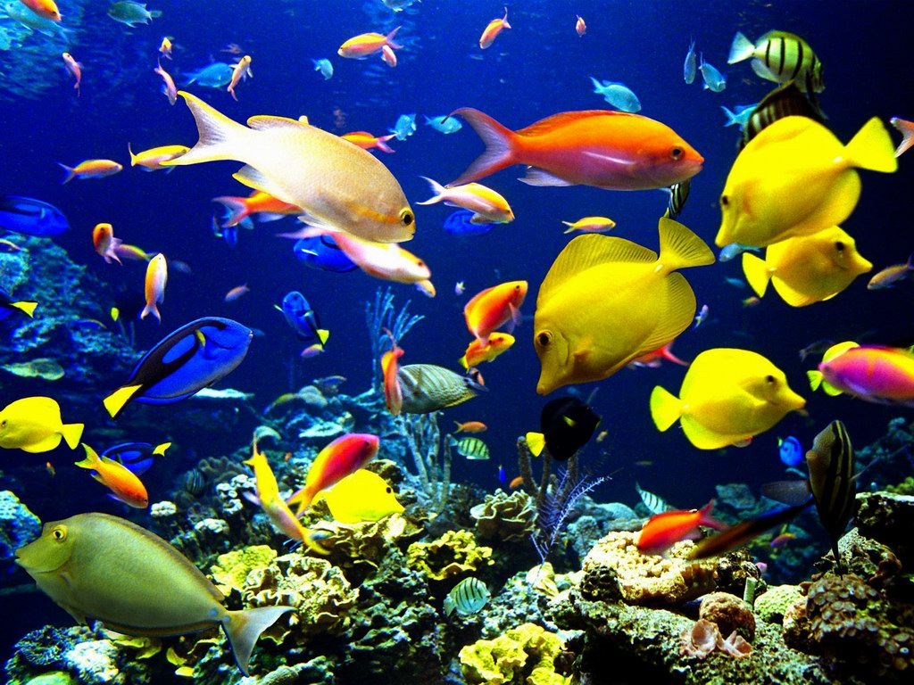
Big Blue Fish and Small Colourful Fish

Slide 2
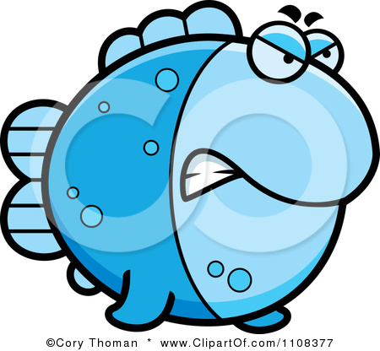
Notes:
This is a Big Blue Fish. She is very, very big

Slide 3
Notes:
And these are Small Fish. They are very, very small. They lived in the deep blue sea. The Small Fish were scared of the Big Blue Fish.

Slide 4
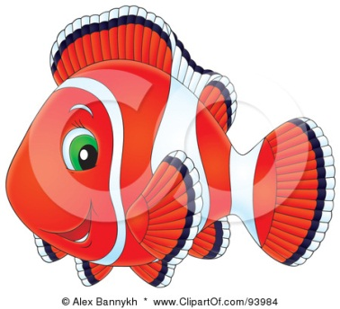
Notes:
Big Blue Fish (in a loud voice): I’M HUNGRY. I’M VERY, VERY HUNGRY! WHERE ARE YOU, SMALL RED FISH?
Small Red Fish: Oh, HELP! HELP! HELP! WHERE CAN I HIDE? (Finds a shell.) I will hide under the shell!
Big Blue Fish (looking around): WHERE ARE YOU, SMALL RED FISH? (finds the Small Red Fish): AH, THERE YOU ARE! I CAN SEE YOUR TAIL!

Slide 5
Notes:
Big Blue Fish (in a loud voice): I’M HUNGRY. I’M VERY, VERY HUNGRY! WHERE ARE YOU, SMALL GREEN FISH?
Small Green Fish: Oh, HELP! HELP! HELP! WHERE CAN I HIDE? (Finds some seaweed.) I will hide behind the seaweed!
Big Blue Fish (looking around): WHERE ARE YOU, SMALL GREEN FISH? (finds the Small Green Fish): THERE YOU ARE! I CAN SEE YOUR TAIL!

Slide 6
Notes:
Big Blue Fish (in a loud voice): I’M HUNGRY. I’M VERY, VERY HUNGRY! WHERE ARE YOU, SMALL YELLOW FISH?
Small Yellow Fish: Oh, HELP! HELP! HELP! WHERE CAN I HIDE? (Finds a rock.) I will hide behind the rock!
Big Blue Fish (looking around): WHERE ARE YOU, SMALL YELLOW FISH? (finds the Small Yellow Fish): THERE YOU ARE! I CAN SEE YOUR TAIL!

Slide 7
Notes:
Big Blue Fish (in a loud voice): I’M HUNGRY. I’M VERY, VERY HUNGRY! WHERE ARE YOU, SMALL FISH?

Slide 8
Notes:
All Small Fish: Oh, HELP! HELP! HELP! WHERE CAN WE HIDE? (Find an old boot.) We will hide behind the boot!

Slide 9
Notes:
Big Blue Fish (looking around): WHERE ARE YOU, SMALL FISH? (finds the Small Fish): THERE YOU ARE! I CAN SEE YOUR TAILS!
Small Fish (from behind the boot): Oh, NO! PLEASE DON’T EAT US!
Big Blue Fish: EAT YOU? EAT YOU? HA-HA-HA! I AM HUNGRY, BUT I DON’T WANT TO EAT YOU. YOU ARE TOO SMALL!

Slide 10
Notes:
Small Fish: OH, GOOD. (Come out from behind the boot).
Big Blue Fish: I’VE GOT A PICNIC. COME AND HAVE A PICNIC WITH ME!”

Slide 11
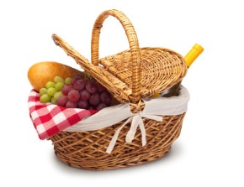

Slide 12
YUM! YUM!
Notes:
Small Fish: OK!
(They sit down, open their lunch boxes and start eating sandwiches together.)

